Slide 1
Capstone Project
Shop For Home
Welcome to the project presentation
java+Gcp_C1
Group no_07
by-
S.Mounika
Prasanna
Nikhil khore
Md Ayaz
B.Shreyank

Slide 2
1
Intoduction
2
Technology Required
INDEX
3
Software Required
4
Frontend Content
5
Backend Content
Shop From Home
6
Conclusion

Slide 3
Introduction
ShopFromHome is a web application for shopping the home decor stuff such as dinning tavles,hanging light ,croceries and other home decoration are available
Online shops give us the opportunity to shop 24/7, and also reward us with a ‘no pollution’ shopping experience.
Online shopping can save time for both the buyer and retailer,
reducing phone calls about availability, specifications, hours of operation or other information easily found on company and
product pages.

Slide 4
Objective
The fundamental purpose of this web application is to facilitate the clear communication between the customer and buyer
and completion of one or more task .i.e. Task include buying and selling goods, transmitting funds and data over the internet.It help to improve the user growth ,engagement, and Brand Awarness

Slide 5
Technology Used
1
Spring Boot
2
Angular
3
Spring Data JPA
4
Bootstrap
5
Java 11

Slide 6

Software Requirements
software
Front-End
Back-End
Database
Server
Angular
Java(SpringBoot)
postgreSQL
Tomcat

Slide 7
Register page
Properties of website
order
Login page
Edit profile
home
Shop For
Home
admin login
Single product page
Admin.product
My wishlist
Admin Discount
My cart
Database
Admin user

Slide 8
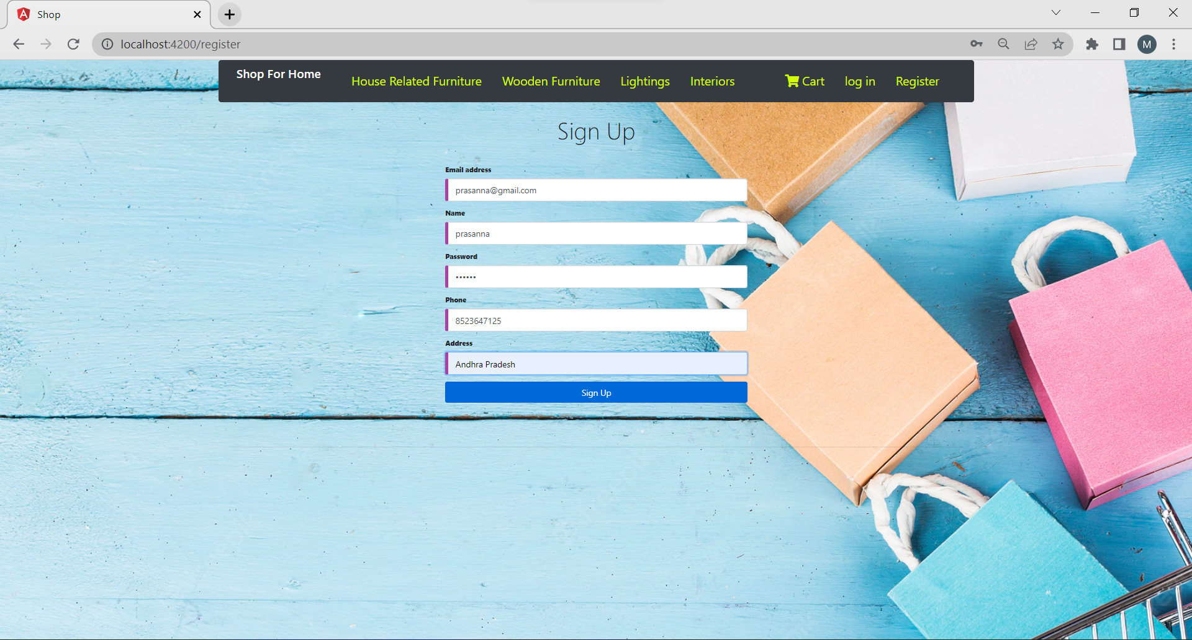
Register Page

Slide 9
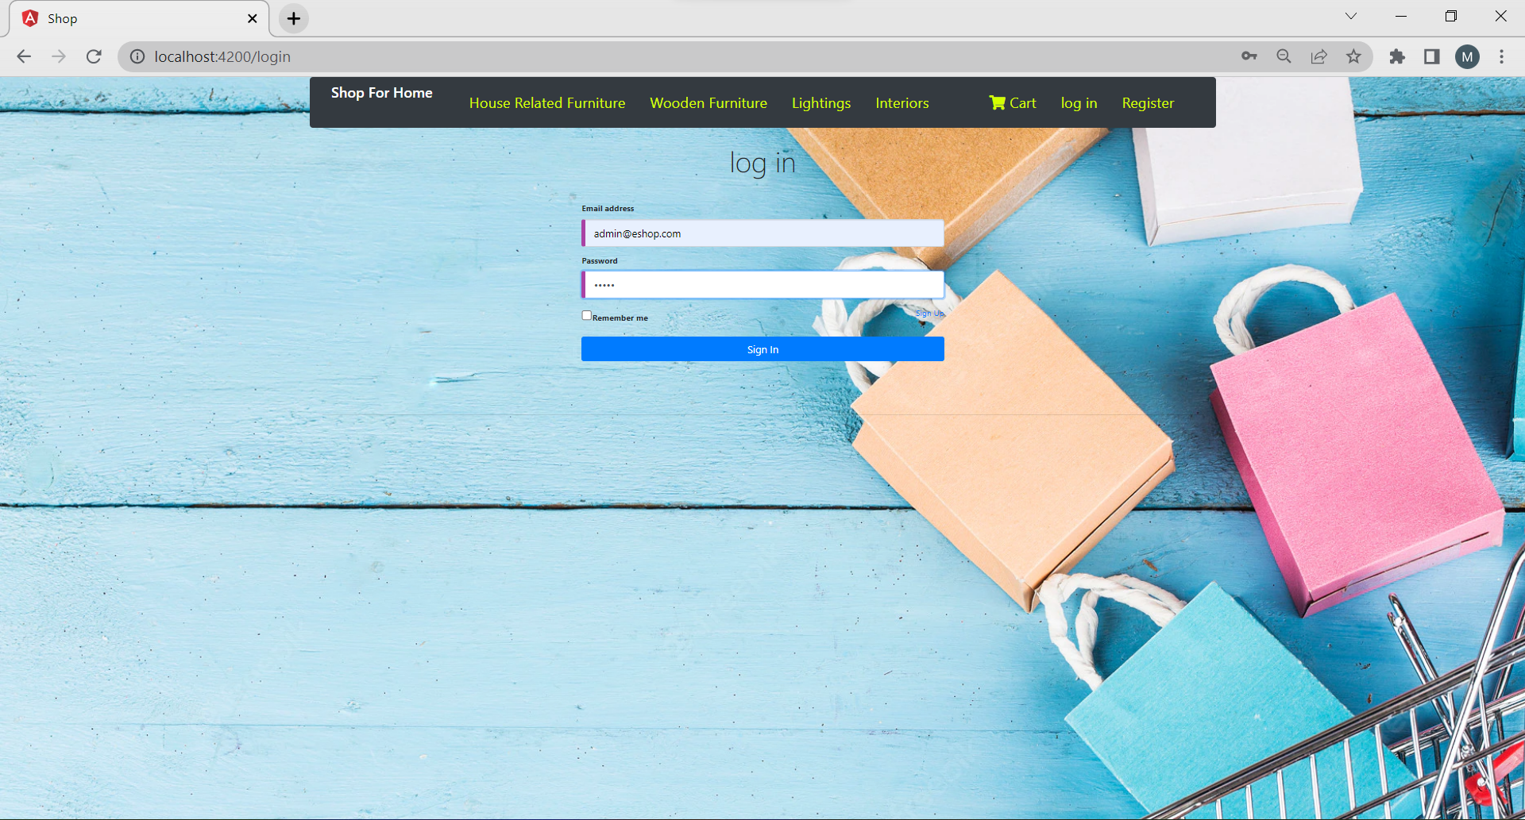
LoginPage

Slide 10
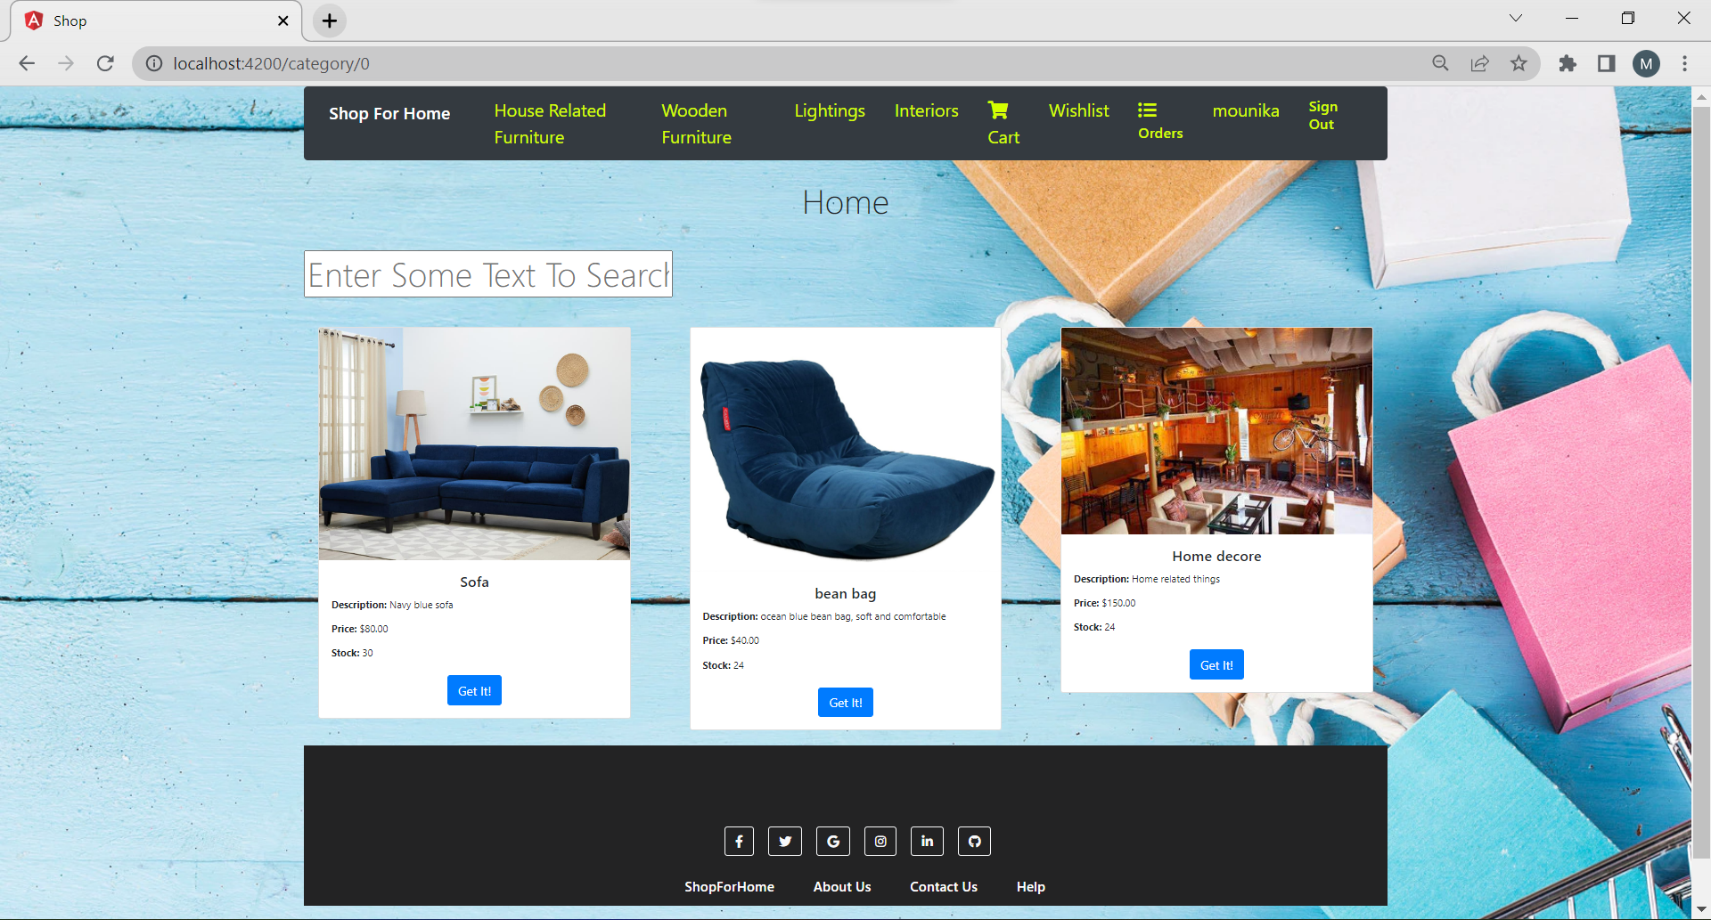
home Page

Slide 11
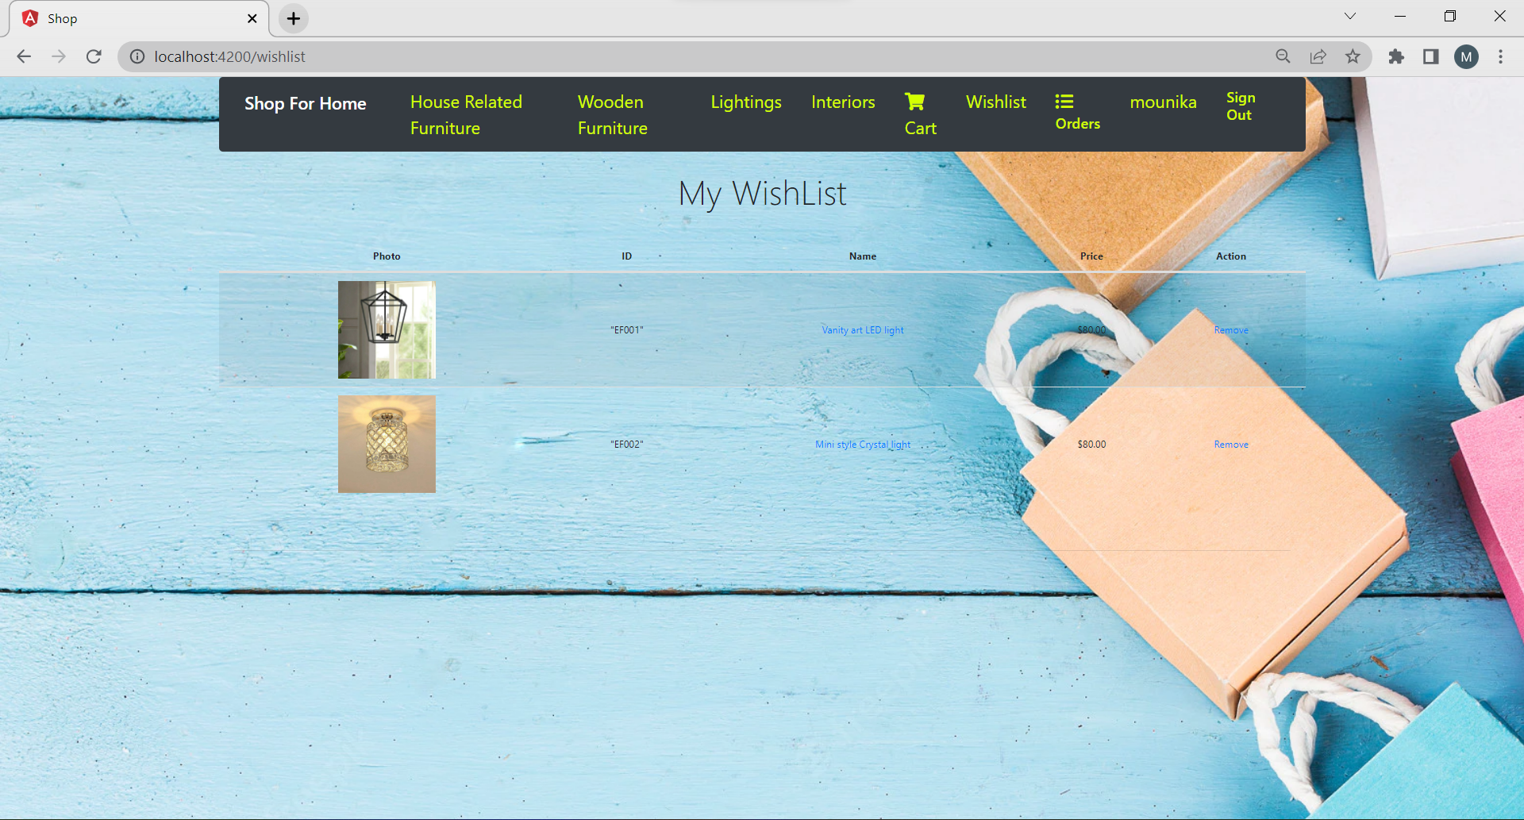
My Wishlist

Slide 12
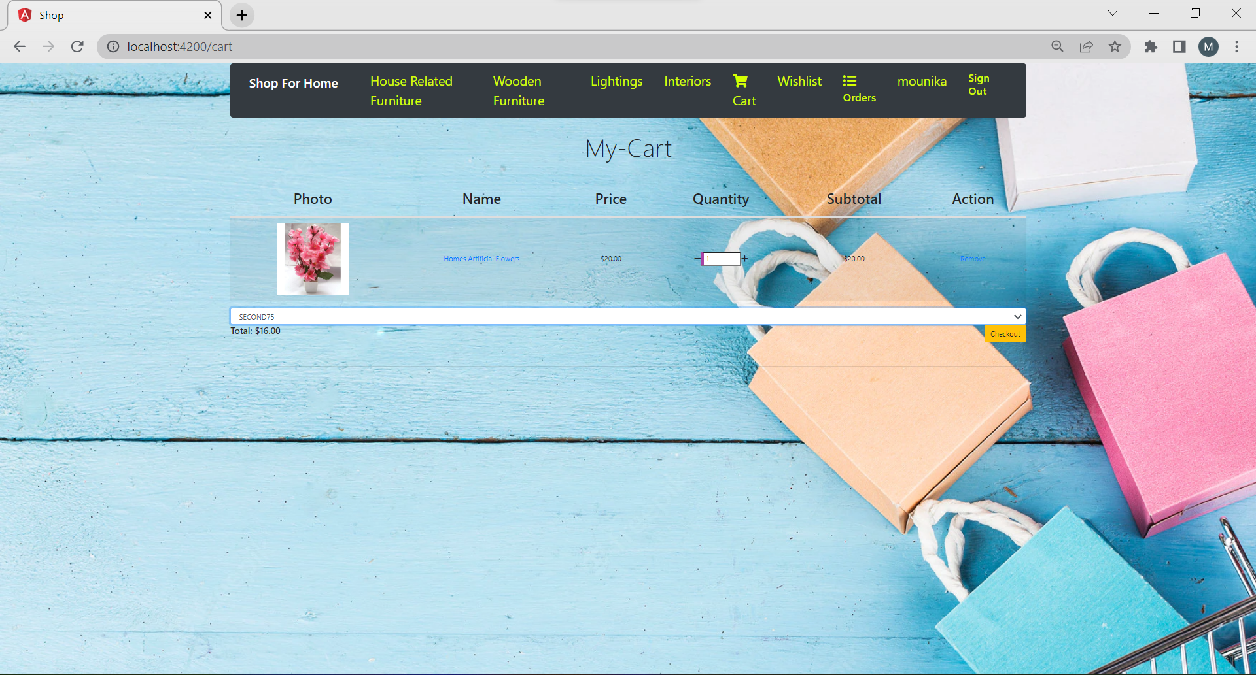
My Cart

Slide 13
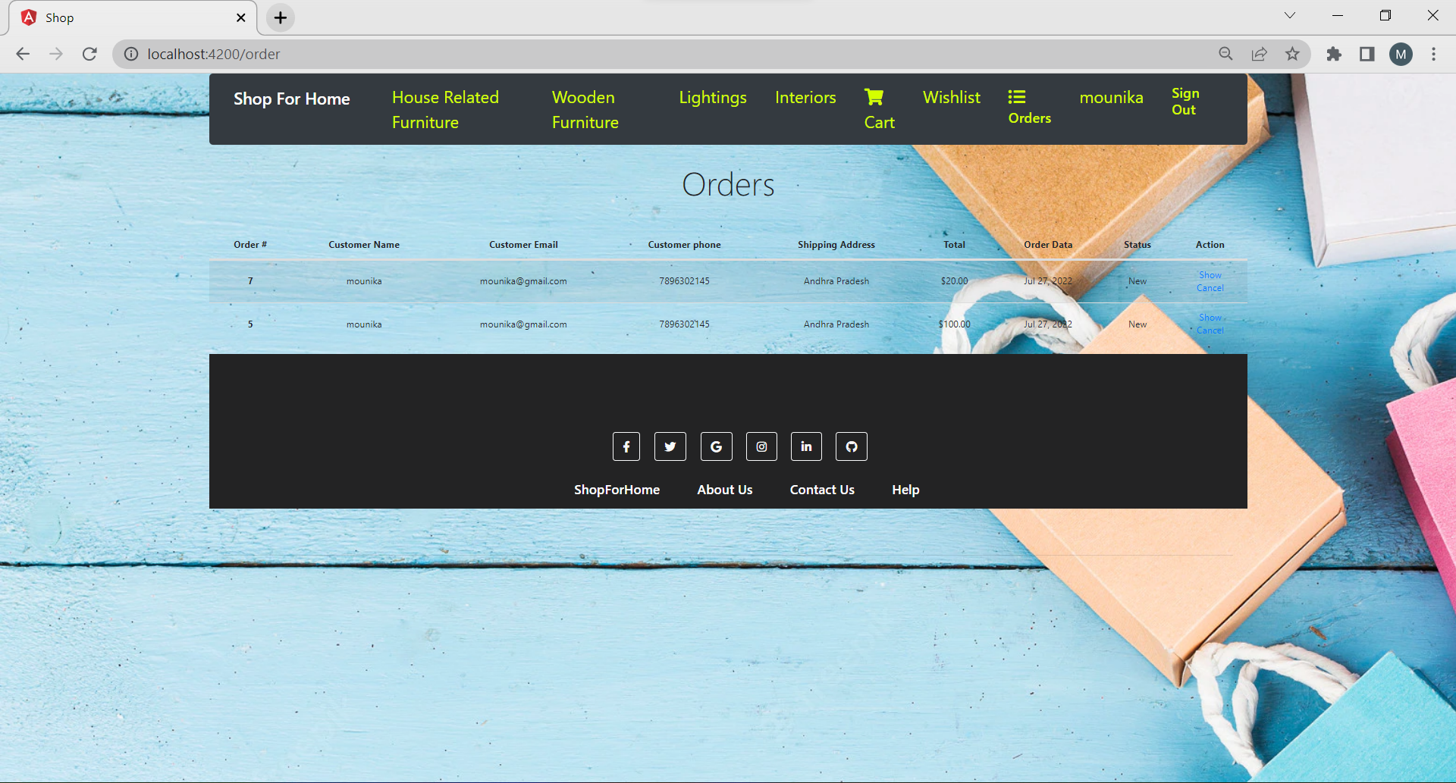
Order

Slide 14
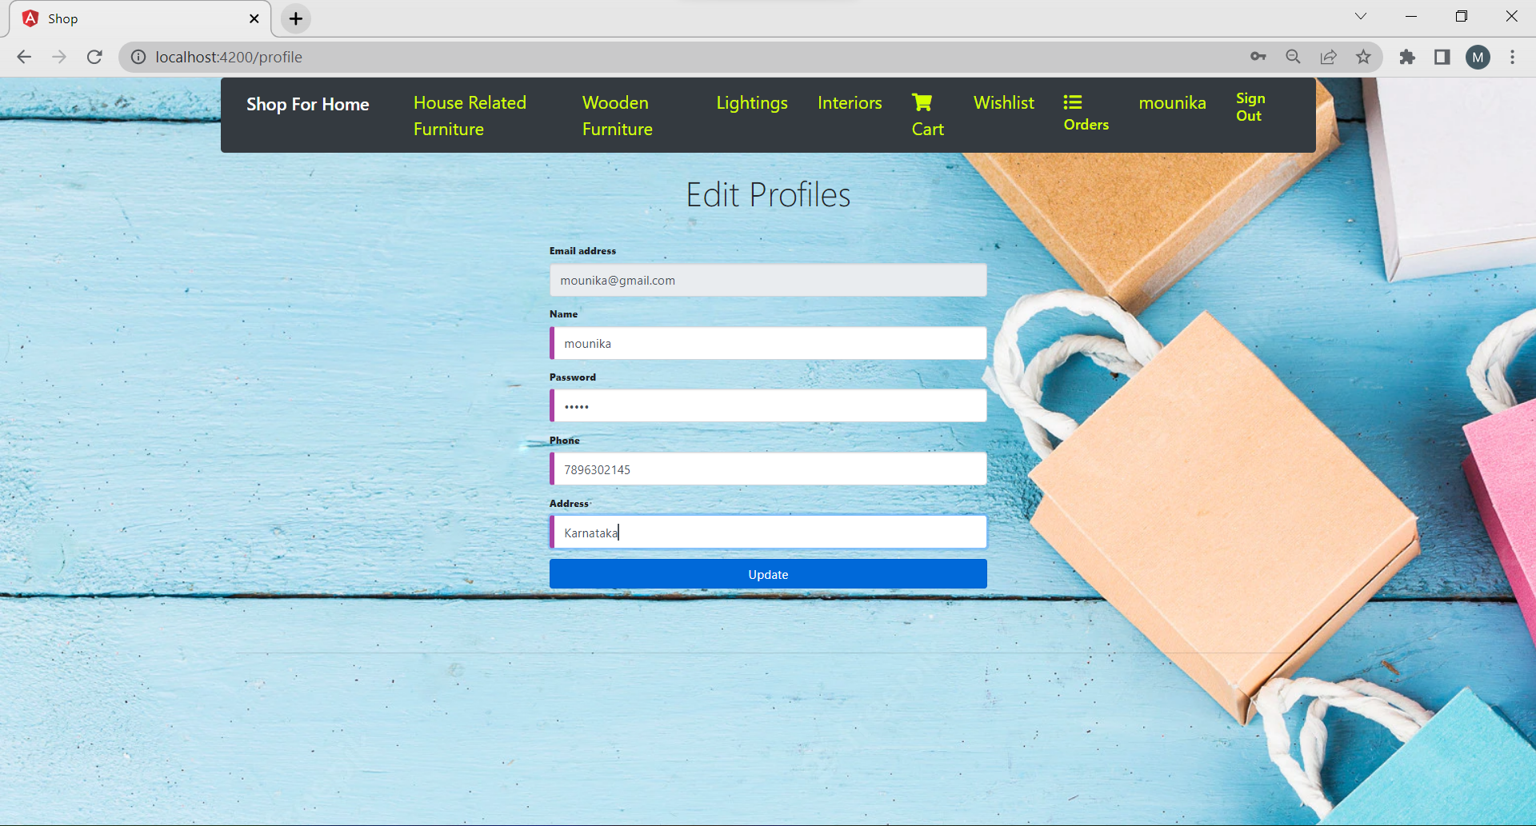
Edit Profile

Slide 15
Admin Login

Slide 16
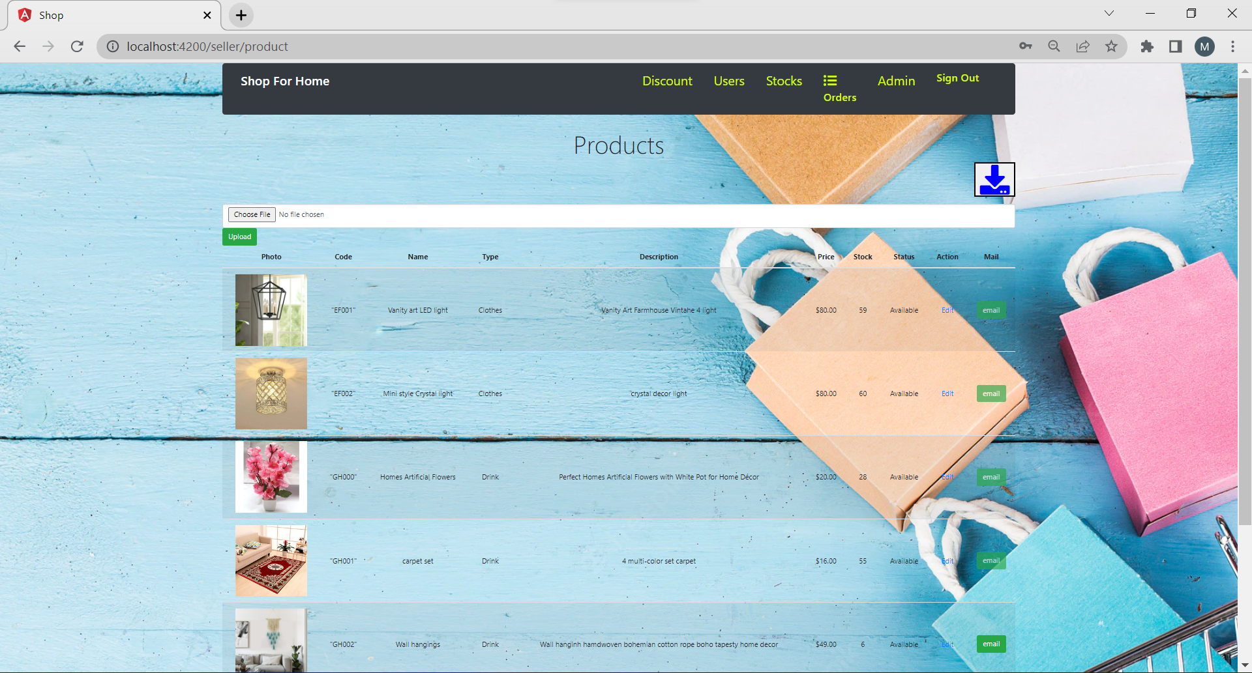
Admin product

Slide 17
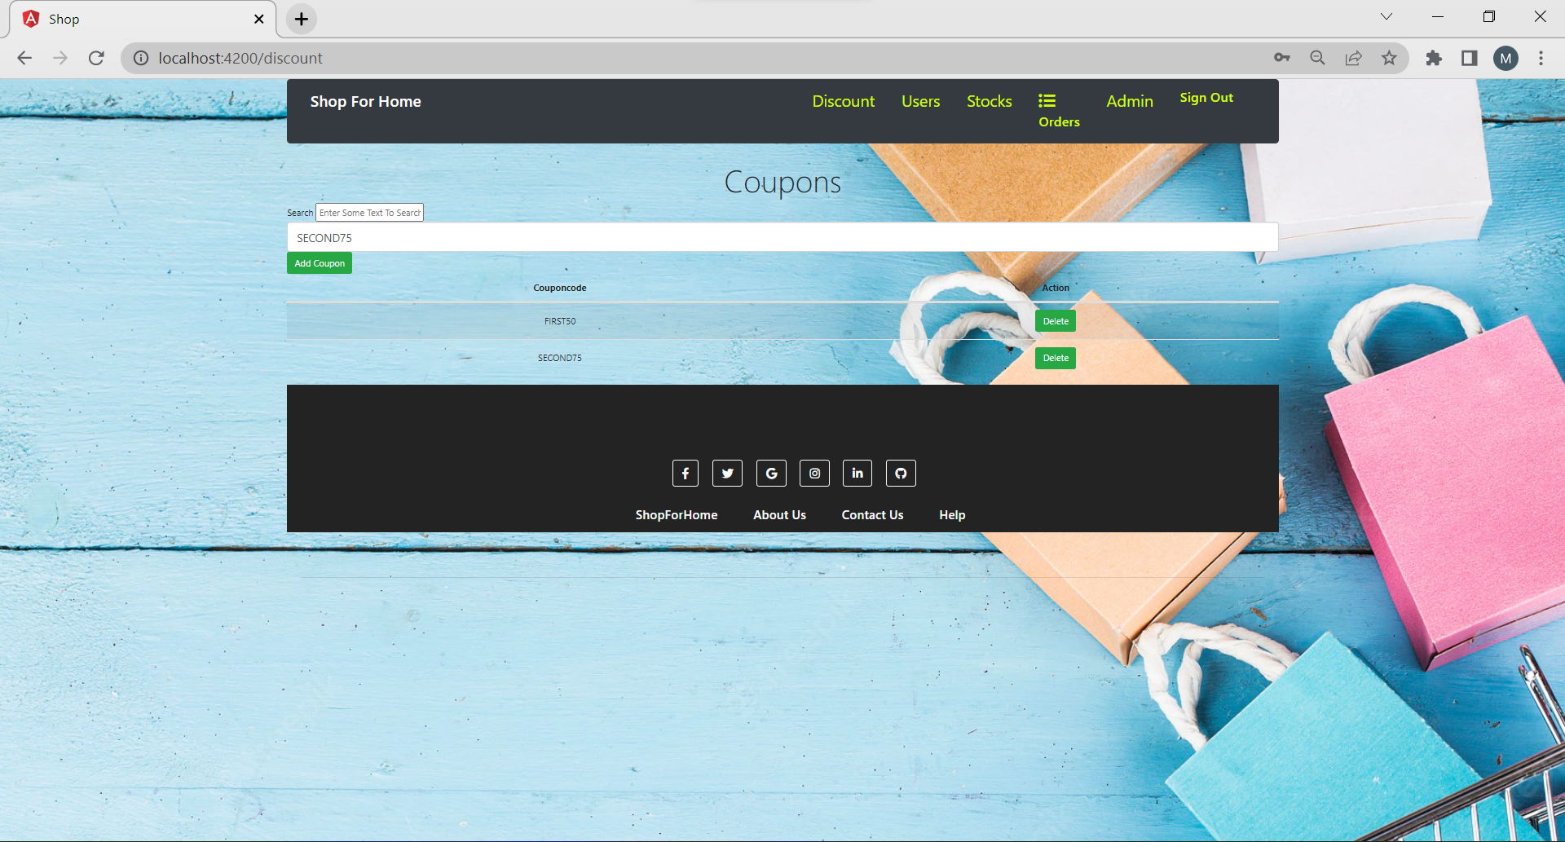
Admin Discount

Slide 18
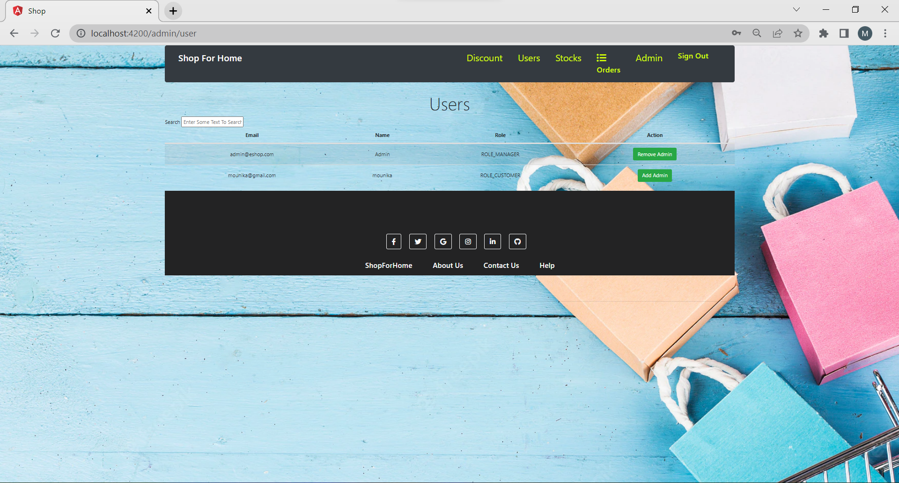
Admin User

Slide 19
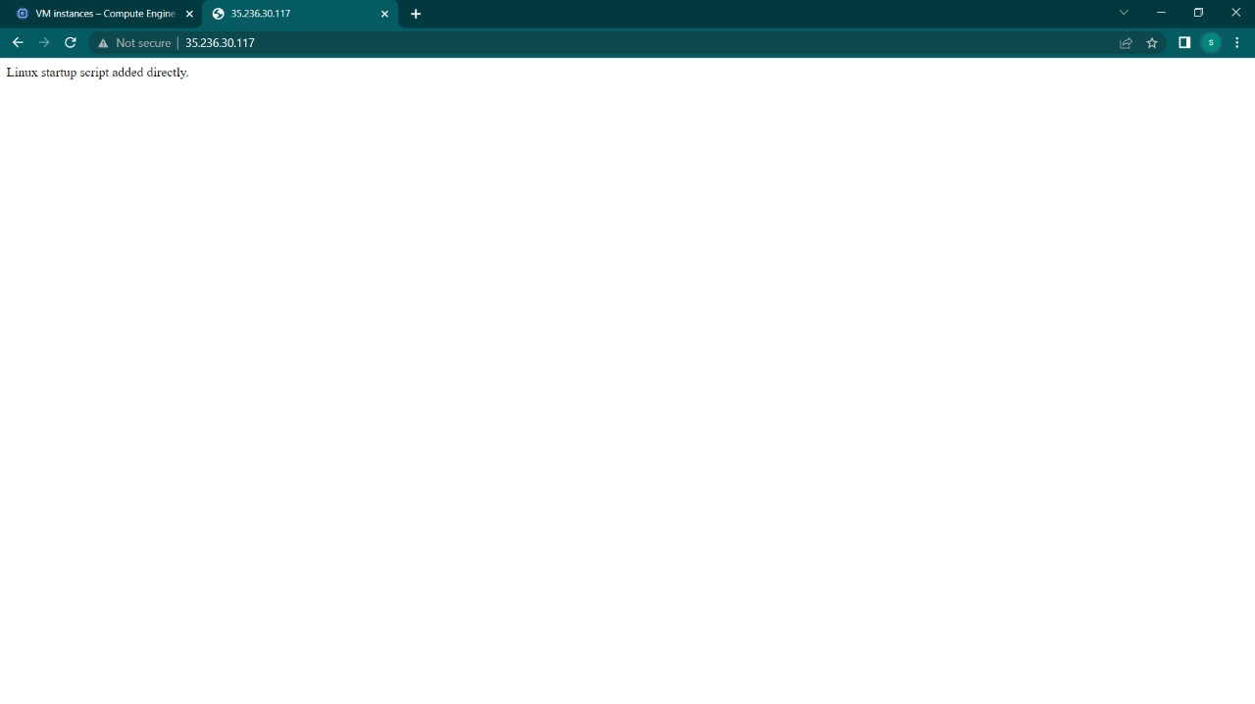
Deployment of Project on Cloud

Slide 20
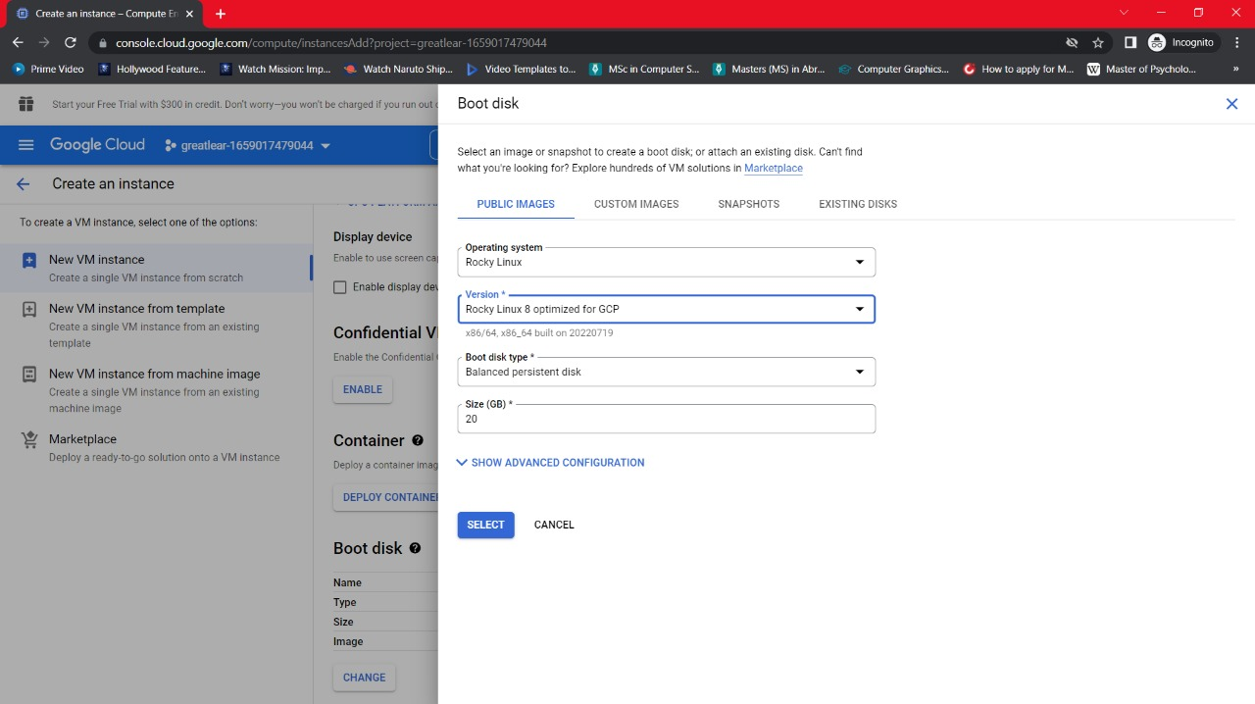

Slide 21
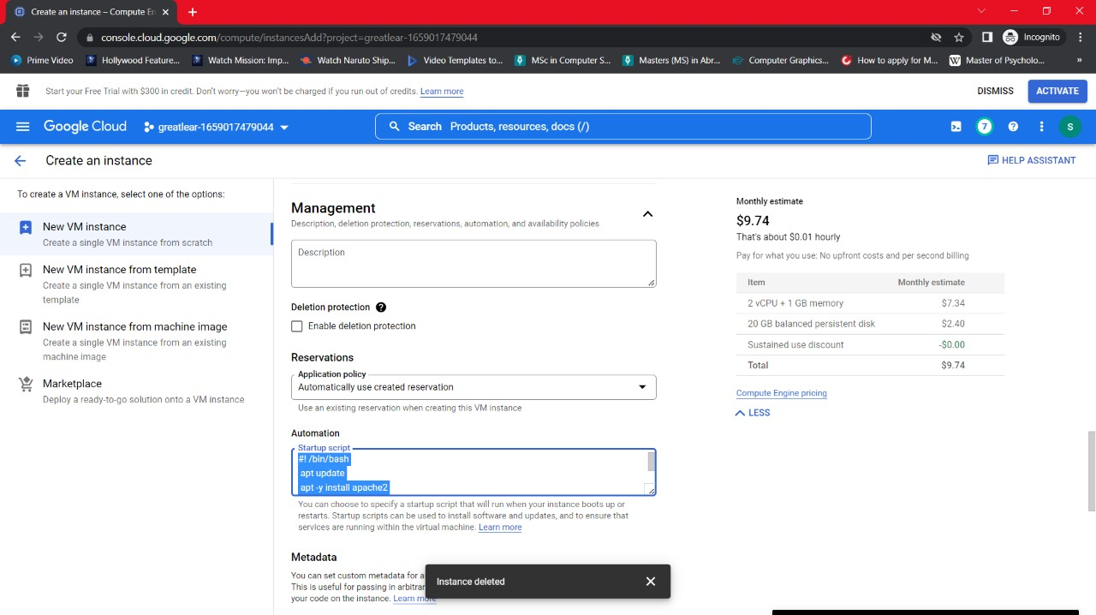

Slide 22
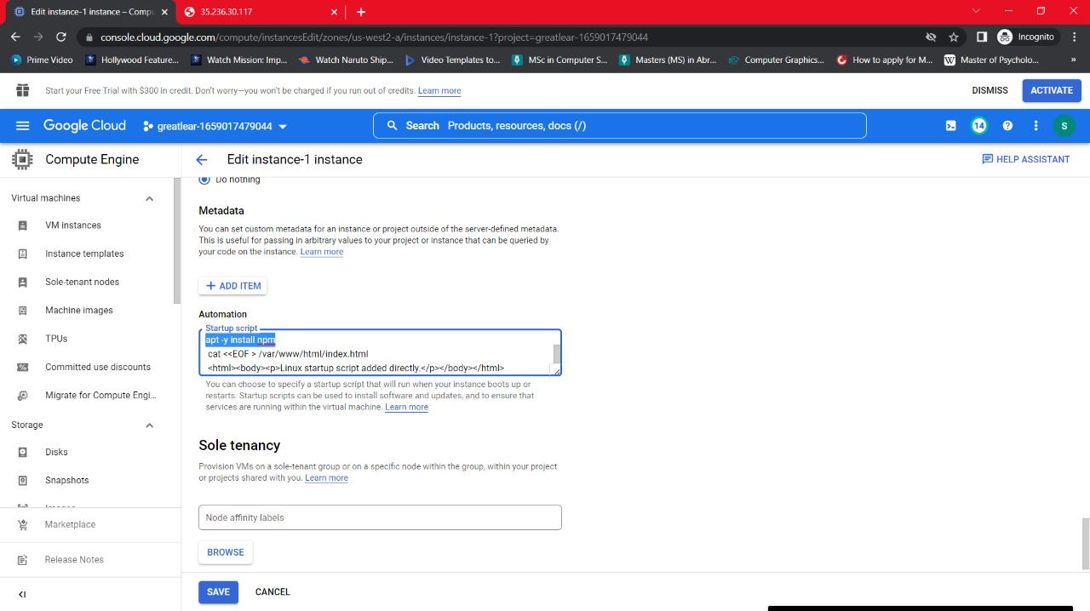

Slide 23
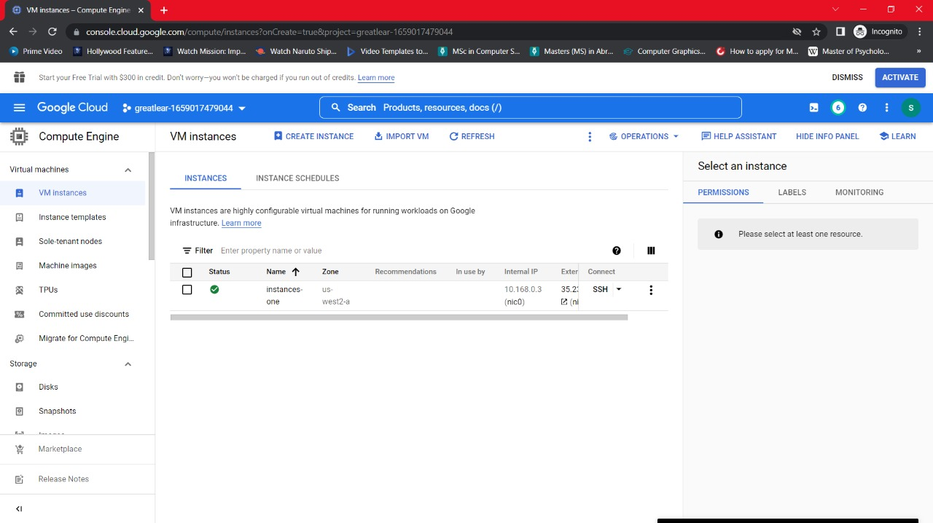

Slide 24
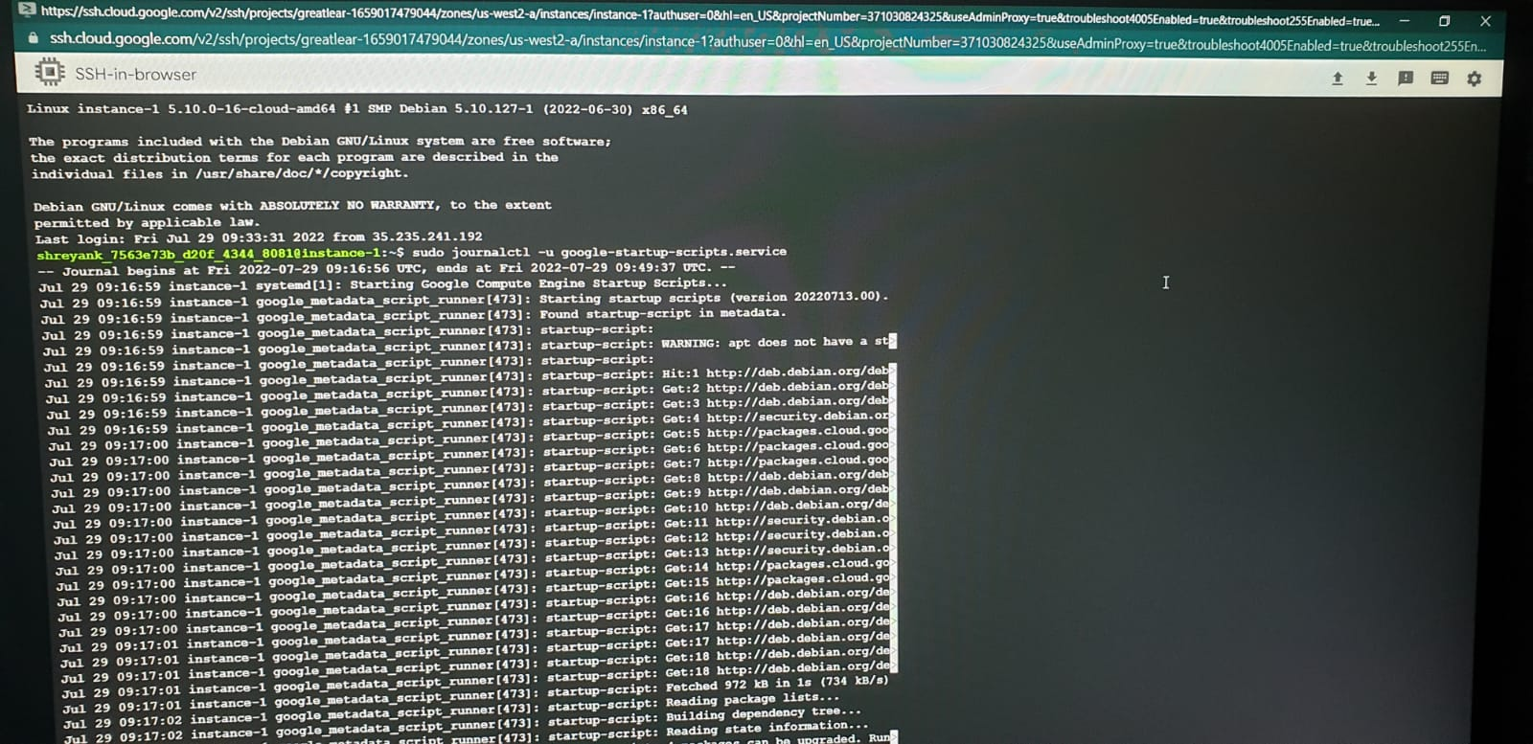

Slide 25
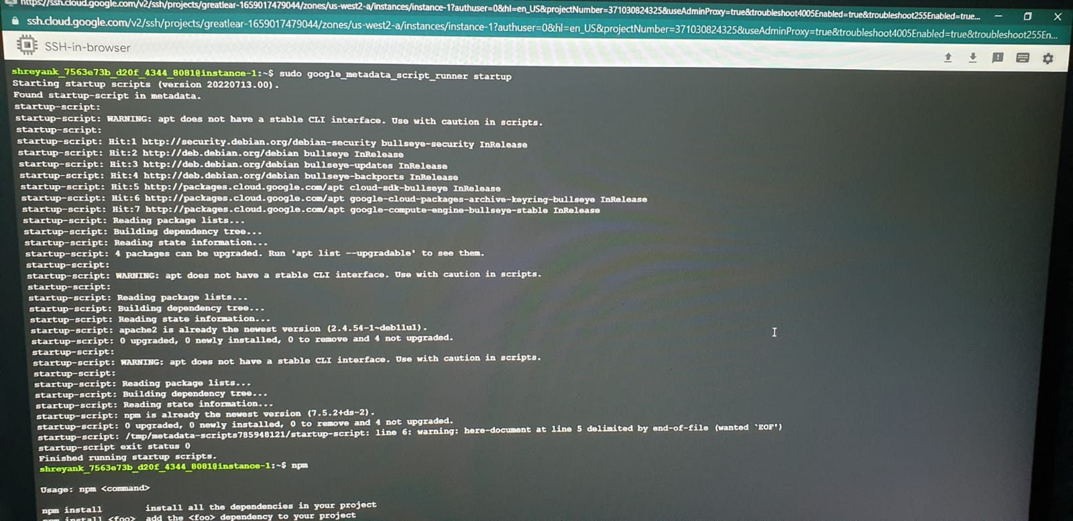

Slide 26
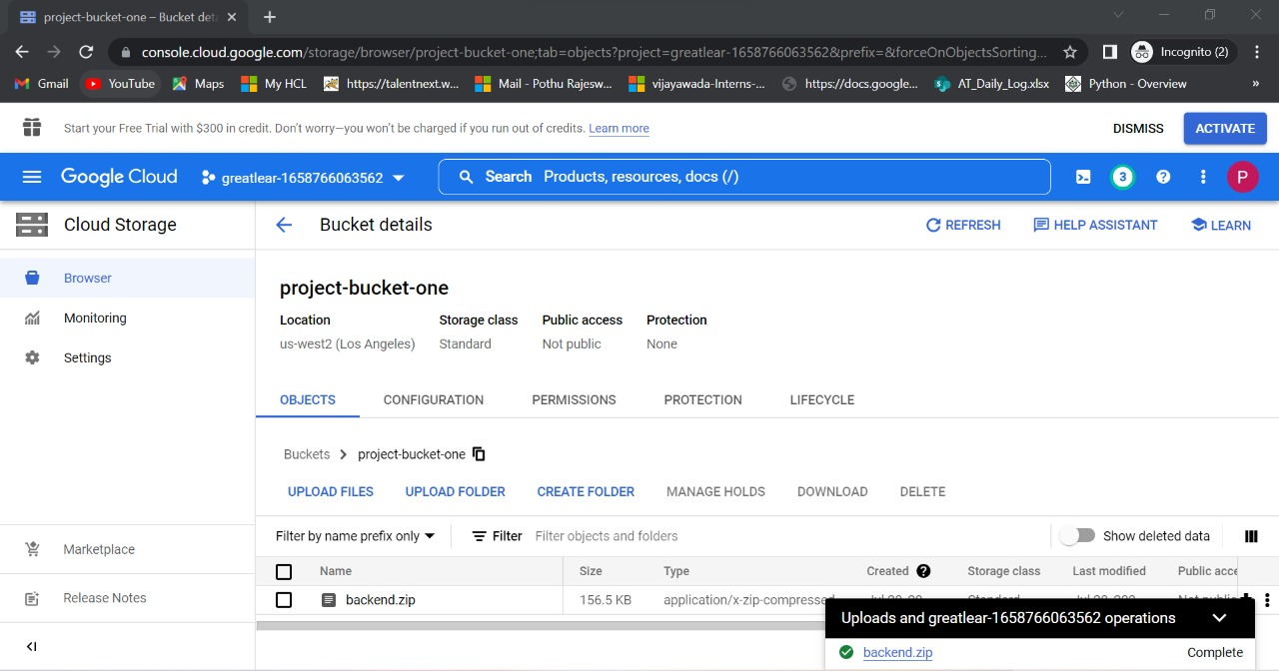

Slide 27
Advantages
1). Faster buying process: Customers can spend less time shopping for what they want.
2). In the proposed system customer not need to go to the shop for buying the products.He can order the product .
3). Customer also wish to buy through the application in his smartphone
4). Cost Reduction : One of the biggest advantages of ecommerce to business that keep sellers interested in online selling is cost reduction
5).Searching :customer search the product int the particular product list

Slide 28
Conclusion
ShopFor Home is a user friendly web Application made for ShopForHome Store. User Can Search For Product ,Add the product in to the cart ,Add the product in to wishlist easily.
Despite of covid of Covid19 this web application can be used to run a business online successfully.

Slide 29
LOGO
Thanks
The original PowerPoint Template

